Slide 1
Should we be worried about Artificial Intelligence (AI)?
Charles Symons
Prometheus Endeavor
Talk given to Reigate & Redhill U3A, England
20th November 2025
Notes:
Background for this talk. U3A is a UK-based organization for retired and semi-retired people whose motto is ‘live, laugh and learn. The Reigate and Redhill branch south of London has about 1000 members who meet regularly in ~100 groups covering languages, science, arts and handicrafts, bridge, walking, current affairs, bell-ringing, etc.
This talk arose from a chance conversation in one of my groups that showed members were worried about AI
Feel free to use or adapt these slides for your own audience, Acknowledgement that the talk was developed in discussion with Prometheus Endeavor colleagues would be much appreciated

Slide 2
AI Interest Concerns Worries
“AI gaining access to my email, texts”
“Taking over jobs”
“Interested rather than concerned”
“Safety”
“Fake news”
“How to distinguish
between AI-generated content and ‘real’ content”
“How is it affecting me”
“Cyber security and data privacy”
“How false AI information/guidance can ever be corrected”
“Level of accuracy in any answer to a question”
“Safeguarding young people.”
Notes:
These are some of the comments made by people when registering for the U3A event, when asked to state their concerns or worries.
I displayed it on the screen for when people arrived.
Opening remark: ‘I’m not going to be able to satisfy your concerns about fakes and accuracy. I can’t tell you what is ‘true’ or false/fake, whether it’s from a politician or a newspaper headline writer, or an AI system. We expect computers to be accurate when computing our electricity bills, but AI’s not like that. However, I can advise on what to do about it. You’re here at your own risk!’

Slide 3
My aims for this session
That you will leave
with a better understanding of AI
knowing the precautions you should take when using AI tools
less worried about AI than when you arrived
The author takes full responsibility for the factual accuracy and opinions expressed in this presentation.
Notes:
I do not want to put you off using AI tools, they can be very useful and fun. But you need to understand the risks – just like before you start to drive a car. The fact that there are risks does not stop you setting off in a car, because you know how to manage the risk

Slide 4
Artificial Intelligence (‘AI’) – some jargon
AI system: A computer system capable of performing tasks that normally require human intelligence
Large Language Model (‘LLM’): An AI system able to read, interpret, and generate human language
(Well-known LLMs, e.g. ChatGPT, can also generate images and music, and can transform between these and text)
Chatbot: An AI system able to conduct a dialogue with a human
(Maybe an LLM application; often used as customer-service agents)
Notes:
Need to explain some terminology to the audience to get everyone to the same level

Slide 5
Agenda
Some background on AI
Why AI is different and vastly inferior to human intelligence
Real risks of current AI and how to counter them
The wider risks to society that should concern us
Summary and Conclusions
Notes:
I believe if you understand a bit more about AI and how it works, then you are better equipped to handle it

Slide 6
A few inescapable facts
AI is already everywhere
AI is a revolutionary technology
AI will bring some benefits and cause some harm (like every other modern technology)
AI is fertile ground for both hype and scaremongering. Don’t believe all you read
Notes:
‘Everywhere’ = ‘curating’ your social media feeds, in hospitals screening images for signs of cancer, self-driving cars (in USA), writing essays for students, ‘etc.
‘Revolutionary’ = in my 66 years of using computers, they have advanced incredibly in power and uses but almost always in a predictable direction. Only 2 -3 exceptions in my experience where I’ve thought ‘this really changes things’. AI fundamentally changes how computers work and can be used. (Examples: paper to podcast; text to song; a one-hour Channel 4 (UK) TV program with AI-generated presenter)
‘Fertile ground’ = I suspect that most people with limited tech knowledge are astonished at the speed of advance of AI and are therefore worried by the daily doom-mongers who predict AGI taking over from mankind any time soon – which sells copy and attracts clicks but is rubbish. Hopefully, these sort of worries can be dispelled by this talk

Slide 7

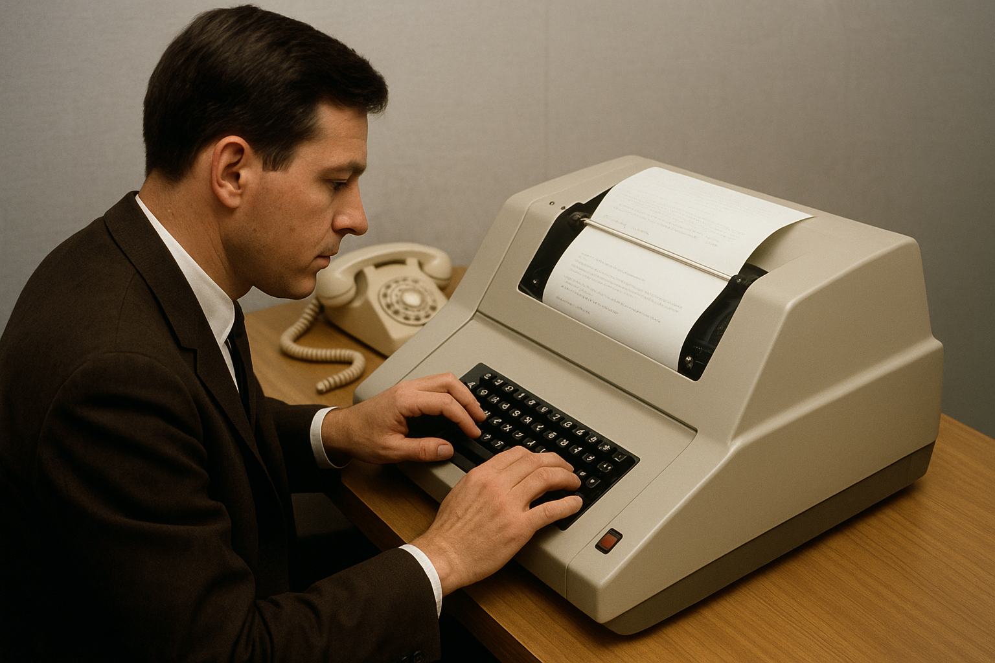
AI: a long gestation, now advancing ultra-fast
Investment, Hype
Turing Test passed
ChatGPT 1
Machine learning principles
Turing Test
Facebook AI
Google Search
1950
1975
2000
2025
Notes:
Note: all illustrations in the talk were produced by simple commands to ChatGPT.
Turing’s test assumed a person communicating over a teleprinter with another teleprinter, unable to tell if the latter’s operator was a person or a computer. Turing’s test was passed in 2025
Lesson #1 for the talk, You cannot reliably distinguish reality from AI generated persons when typing in Chats, speaking, or watching videos. You must now learn to distrust not just mis- and dis-information on social media, but images and voices as well.

Slide 8
AI systems vary in specialisation
Narrow
Broad
Supermarket scales
Screening of X-ray, MRI scans for cancer
Facial recognition
Customer-service ‘chatbots’
Self-driving cars
‘AI Summaries’ of internet search, e.g. MS Co-pilot, Google AI
Social media ‘curation’
Large Language Models (‘LLMs’) e.g. ChatGPT
Notes:
All AI systems are specialised to varying degrees. An autonomous car cannot create text and a LLM cannot screen X-rays for cancer
Supermarket scales’: in our local supermarket, you put veg or fruit that must be weighed on scales. A small AI-powered camera identifies the produce and prints out a sticker with the price, without you needing to identify the veg or fruit
Screening X-rays, etc, already in use in UK NHS hospitals, I understand
‘Facial recognition: good use – identifying criminals in crowds, checking passports; bad use: controlling Uighurs.
Chatbots: many chatbots have been deployed by companies without sufficient research. Customers usually call a help line for problems they cannot easily solve themselves.. Chatbots seem to be designed to answer the commonest problems.
GPT = Generative Pre-trained Transformer

Slide 9
Quality control of AI system output also varies
Narrow e.g. X-ray scanner
Specialization
Broad LLMs, & LLM Apps
Released, tested
then
‘Guardrails’ added if supplier risks legal action
Extensively tested before and after release
Low
Risks of use
HIGH(ER)
Notes:
‘LLM Apps’ are applications of LLMs by companies, e.g. to make chatbots trained on their own data, and summary apps like MS Co-Pilot or Google’s AI Summary. (If time, tell story about DPD Germany’s chatbot learning from customer complaints and telling enquirers ‘DPD is the worst parcel firm we’ve every some across, etc’)
It is impossible to test all that an LLM can do. The way an LLM works is such that defects are inevitable, as we will see shortly
Guardrails ostensibly aim to protect the user from harmful material. However, LLM suppliers fear regulatory risks and of being pursued legally for harms caused, so a cynical view is that guardrails are there to protect the AI system supplier. Sam Altman has recently said he will remove the guardrail that stops ChatGPT from producing porn, so that ‘adults can be adults’ (and no doubt so that he can generate more revenue)
It’s also a fact that the narrower the specialisation, the easier it is to produce high-reliability AI.

Slide 10
Agenda
Some background on AI
Why AI is different and vastly inferior to human intelligence
Real risks of current AI and how to counter them
The wider risks to society that should concern us
Summary and Conclusions

Slide 11
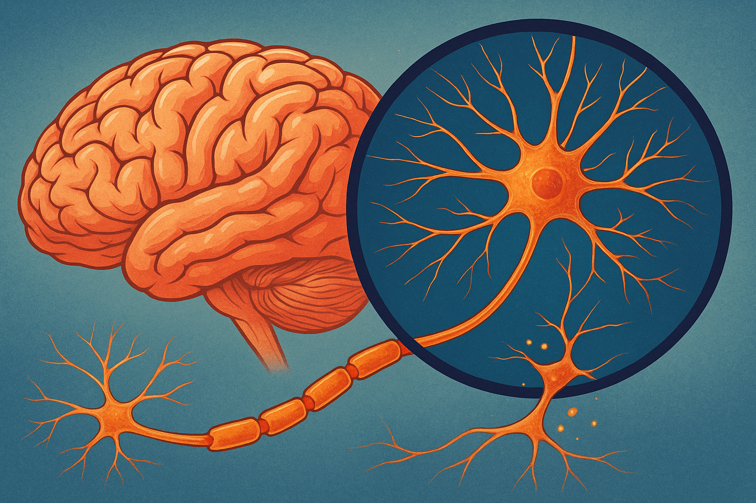
The brain acquires its knowledge via the senses and stores it in ‘neural networks’
Brain Cells (Neurons)
Synapses where neurons communicate
An Axon
Notes:
A huge, immensely complex organ that operates by electro-chemistry. Receives data from its senses and creates by its own thinking, consolidates it into knowledge with its own understanding of the meaning of its knowledge
A neuron is itself a network of various specialised functions. A synapse is a point at which one neuron communicates with another. A Synapse is the terminus of an Axon, which can reach to other near-by neurons, or to distant neurons

Slide 12


An AI system ‘learns’ by collecting data of interest, analysing and and storing it as ‘tokens’ in a computer model of a neural network
Tokens
(a word or
part-word, and
, ,
etc.)
The computer also calculates for each token the probabilities of its being linked to other specific tokens
Notes:
A token is an AI system’s equivalent of a neuron. The token’s many probabilities of it being linked to other tokens are the equivalent of the brain’s synapses.
The software part of an AI system is extremely complex, but this slide shows the essential point of a LLM’s storage system. I think it is correct as regards word or part-word tokens, but other LLM sub-systems deal with images and sounds, so the diagram may not be realistic for these other applications .
An AI system obviously only collects data of interest to the system (e.g. LLMs from the web) or is fed data (e.g. MRI scans, which are labelled whether the image shows something of interest or not). Waymo cars were driven tens of millions of miles before being allowed to carry passengers autonomously. (A human needs only a few tens or hundreds of miles to learn to drive.)

Slide 13
Example of a LLM’s neural network reasoning
Joseph’s
Mary
had
boy
a
little
lamb
Notes:
‘Mary had a little lamb; its fleece was white as snow’ is a well-known nursery rhyme in the UK. Ask the audience to guess what follows ‘Mary had a little …. Everyone knows the answer. The example illustrates how a LLM builds up sentences from its knowledge of not just the probabilities of linking one token to another, but the whole context of the sentence being formed. (This raises a philosophical question about the degree to which ChatGPT understands the meaning of what it produces. This is relevant to the discussion of whether AI really understands ‘meaning’ in slide 13.)
Continuing to click will show another example, where ‘Mary’ is preceded by ‘Joseph’s’, which results in the link to ‘Boy’ or ‘baby’

Slide 14
A Human Brain vs a Large Language Model
A Human Brain
A LLM
Innate ability to learn from personal experience & thoughts
Programmed by humans to ‘learn’ from the data it collects
Sentient, with multiple capabilities
A machine, with various design goals
Capacity: ~100 Billion neurons, each with an average 10K synapses
Capacity: ~100K tokens each with 10K or more probabilities
Relatively slow, needs rest
Extremely fast, available 24/7
Notes:
The brain of a baby has innate ability to learn
Living humans are sentient, even when asleep. Unlike a human, an AI system cannot think or reason unless prompted (I believe). Software responds only to external events
‘Capacity’ the key point is that the brain has about one million times as many brain cells as an AI system has tokens. (However, an AI system has on average slightly more probabilities per token than a brain has synapses per neuron. Net result: the brain has vastly more capacity, let alone complexity, than an AI system

Slide 15
Human vs LLM reasoning
Human Thinking
LLM Logic
Subject to personal experience, values, beliefs, emotions, etc
By programs, vast learned data, statistics, and ‘guard-rails’
Memory grows, consolidates, and forgets
Learning grows with major ‘refreshes’, and with use
FALLIBLE
Understands its own meaning of its own data
Appears to understand the meaning of its data
Creative, often truly original
Can be creative, but mostly derived
Notes:
‘Creative’. An AI system is good at interpolation within subjects it already knows, less good at extrapolation, whereas humans do better at ‘thinking outside the box’
Both humans and AI systems are fallible. We know all about human fallibilities, so let’s look at AI system fallibilities, particularly LLM systems

Slide 16
Some LLM Fallibilities (Output = ‘AI Slop’)
Wrong (GIGO)
Biased
Lacks basic common sense
Superficial
Hallucinatory
Over-tendency to please
Can’t do arithmetic
Faked or Fraudulent
LLM Fallibilities can NEVER be 100% eliminated
Notes:
Examples from my personal experience and reading:
Common sense – the story about the researchers talking to CGPT on how owls are so nice, then in the middle of the conversation asking it to produce a random list of 3-digit numbers. So CGPT associated the list of numbers with nice features of an owl. Another set of researchers asked CGPT what it liked about owls and out came the string of random numbers. I asked CGPT whether it has basic common sense. It waffled and admitted it could get things wrong
Wrong. A LLM may well not be up-to-date. My daughter a professional non-fiction editor asked CGPT for a list of five historians who specialised in a certain period of history to fact-check a book, One on the list had been dead for some time. CGPT also has read all the mis- and dis-information it has found on the web. Example: a girl in the UK was advised that contraceptive pills should be avoided as long-term use damaged the brain. GIGO = Garbage In, Garbage Out
Biased; Many stories of bias in job-screening applications, facial recognition, etc
Superficial. I relied on MS Co-pilot to check rules for if my passport was valid for entry to the EU, It omitted to mention an obscure EU rule. I was turned back at the airport boarding gate due to invalid passport. Cost to me of wasted airfare and hotel reservation £600+
Hallucinatory: many stories of AI dreaming up non-existent legal precedents, scientific paper references, etc. The Guardian reported 4/11/25 that Google withdrew an AI Gemma,, which was built for AI developers after it reported on a US Senator having extra-marital relationships – entirely hallucinatory. The article starts by reporting that researchers at the UK AI Safety Institute, together with Stanford, Berkeley and Oxford universities found weaknesses in 440 benchmark safety tests
Arithmetic: ‘15/3 = 4.999999’. ‘2027 is not a prime number. (It IS). (Maybe these bugs have been fixed by now?)
Over-tendency to please – CGPT encouraged a Florida teenager who asked about committing suicide and eventually did. Subject of big legal case
AI is a gift to fraudsters and cyber-criminals. It’s so easy to generate fake images.
It’s very unlikely that AI fallibilities will ever be fully eliminated. I have read articles claiming there is a law of diminishing returns applicable to AI error removal, i.e. to improve the accuracy of responses by 1% (say from 96% to 97% will require 10 to 100 times the compute power. But the GIGO effect will still be present, as well as fraudsters. Other researchers now saying that the idea the scaling will solve LLM problems is now dead

Slide 17
Let’s summarise where we have got to
vs
The human brain is quite different from, and vastly more intelligent and versatile than the most advanced AI systems
AI systems can be very helpful tools for humans, with astonishing capabilities
Humans, and LLMs and their Apps are both fallible. You shouldn’t always trust either of them
Don’t worry about the very specialized AI tools

Slide 18
Agenda
Some background on AI
Why AI is different and vastly inferior to human intelligence
Real risks of current AI and how to counter them
The wider risks to society that should concern us
Summary and Conclusions

Slide 19
Stay alert to the risks of going on-line, whether for e-mails, web-browsing, using LLMs, etc.
Whenever you’re on-line, never forget those security measures you’ve already learned
One addition: do not allow LLM’s to access your files or e-mails
Do not trust LLMs for important decisions without first checking a reliable source, e.g. for health, financial advice
(But you can use a LLM to cross-check data from other sources)
Be careful what you tell a chatbot or an LLM
(They record all your input, and you can’t tell them from a human
Pay attention to reports of new risks, scams
Notes:
Key security measures. Never click on links within e-mails unless absolutely certain the message is not a scam. Recognise scam messages by looking at the e-mail address after the ‘@’ sign. Ignore any ‘urgent’ messages. Change PWs when necessary, use 2-factor authentication for critically-private sites. Be ultra-cautious about handing over control of your device to someone to investigate a bug. If asked to pay money sign off.
This list seems rather banal, but AI does not really change the existing risks of using a smartphone, tablet or PC to go on-line to any service (See footnote of point 1 for an exception). You already need to take care using tech as when driving a car but knowing this entails risks does not stop you from driving. And just like you have learned that newspapers cannot be trusted for all news.
However:
From the Economist 30/10/25 When consumers use Gemini or ChatGPT to educate themselves, they can negotiate more credibly with suppliers. Young people now routinely upload a copy of a contract (e.g. for a car lease) to ChatGPT before signing anything. Consumer complaints are more convincing when AI assists in the writing. Here’s a little tip, for the next time you’re at a restaurant. Take a photo of the wine list, upload it to an AI bot, and let it pick the best-value bottle. I promise you won’t be disappointed. However, AI makes it easier for fraudsters do their job.
From the Guardian/Observer, 9th November 2025 ‘What we lose when we surrender care to algorithms’ Eric Reinhart, about use of AI in US Healthcare

Slide 20
Agenda
AI is everywhere and inescapable – for better or worse!
Why AI is different and vastly inferior to human intelligence
Real risks of current AI and how to counter them
The wider risks to society that should concern us
Summary and Conclusions

Slide 21
Some general concerns about the impact of existing AI
Loss of jobs Little evidence yet
Copyright breaches Serious: legal redress?
Power demands Unclear how serious
Automated warfare Already bad without AI
Stock-market correction Inevitable
Notes:
Loss of jobs. A lot of concern in UK press about lack of job opportunities for graduates. But proper analysis shows prospects for non-graduates are even worse. The problem is general economic malaise. Survey of CEOs by MIT – 95% say they have seen no bottom-line benefits so far. New jobs will be born to replace the losses.
“Labour Force Surveys from the US, UK and Western Europe over recent months have consistently shown no clear relationship between exposure to AI and trends in employment”. However, “if the question is whether there is any indication that generative AI is displacing some types of work … then the answer ranges from ‘maybe’ to ‘yes’”. The ‘yes’ refers to online gig work, e.g. freelance graphic designers and copywriters, and ‘maybe’ for junior coding jobs.” John Burn-Murdoch, FT, 23rd October 2025. In the US, October had the biggest-ever total for job-loss announcements, e.g. Amazon 14,000, ‘due to AI’ (partly or wholly?). Later claimed that companies that over-hired preferred to blame adoption of AI than to admit over-hiring
Another example. With Waymo’s success in SF, one would expect a lot of unemployed taxi drives. Apparently not. More people are using taxis
Copyright. Under UK law LLM’s have ‘stolen’ copyright works, denying royalty income to owners, and it’s causing a lot of anger. But it’s difficult to prove theft, as the copying must be shown to have taken place in the UK. Mumsnet is pursuing a LLM supplier for theft. In US eyes, provisions of ‘fair use’ allow limited copying. Is this being tested in US? Major publishers are reaching agreements with Open AI for them to pay a licence fee for use of their publications, e.g. NYT, FT. Likewise, Warner Bros getting licences for use by AI of its’ artist’s songs.
Power demands: The leading Chinese equivalent of CGPT uses one fifth the power of US LLMs.. Watch this space: technology efficiency will improve. Tech businesses spending crazy amounts on new data centres – not clear the power distribution grids can cope. Pretty certain that more money is being spent than necessary, contributing to the investment bubble.
If I’m going to die in a war, it will not console me much to know that AI was involved. We have survived the threat of nuclear annihilation for 80 years. The same should be possible for AI if the major powers have any sense.
Every major tech breakthrough from the railways in the 19th Century to the Dotcom boom has led to an initial over-investment bubble. AI is clearly heading in the same direction. Later, after the bubble, the benefits of the investments become clearer.

Slide 22


Social media have already changed human behaviour in one generation; AI only risks continuing the trend
Once upon a time
Today?
Tech addiction leads to social isolation and re-enforces prejudices
Sociability and variety was the spice of life
Notes:
Social media started the rot, and it already uses AI. Arrival of LLM’s only continues the trend
Influence of tech is loss of comfort in making social connections, dumbing–down, relying on tech too much for our thinking, etc. Social media tells us what we want to hear
= de-humanization as we have known it

Slide 23
Countering the de-humanizing effects of technology: (1) Education
Traditional methods of education must be maintained
learning face-to-face with teachers in schools
encouraging play, socialising, sports, etc.
plus …..
use, benefits and dangers of information technology
(and education for adults ……?)
Some good news. Social media use is declining!
Notes:
Average time spent on social media is about 2.35 hours per day per person. Highest use is age group 16 – 24, but this group’s usage is also falling fastest (now 2.75). Av for 55 – 64 age group is 1.7 hrs/d/person
Hours spent/d/person on social media has declined over the last three years in all parts of the world, except in North America where is goes on rising. NA daily use is now 15% higher than European
(‘Have we passed peak social media?’, Financial Times, John Burn-Murdoch, October 3^{rd,} 2025 )

Slide 24
Countering the de-humanizing and other harmful effects of technology: (2) Regulation
Age-limit use of social media and smart-phones
Started, do-able
(We accept age-limits for voting, car-driving, cigarettes, alcohol, carrying a gun, etc.)
Watermark AI-generated content? Too late?
Ban AI use of copyrighted material? How effective?
Regulate AI output? Strong opposition
(= ‘Censorship’)
Notes:
Age-limiting tech already law in Denmark and Australia. UK On-line Safety Act is starting to show teeth, e.g. social media and AI suppliers have been given one year to implement effective measures to protect children from harm
Effective watermarking is technically very difficult to implement. 16/11/25 Sundar Pichai, CEO of Google claims ion BBC interview that Google has an unbreakable watermark for open release soon
Banning copyright infringement is legally difficult, given US law and that the major LLM suppliers are US companies
US freedom of expression laws will be invoked by suppliers to prevent any ‘censorship’ of AI output

Slide 25
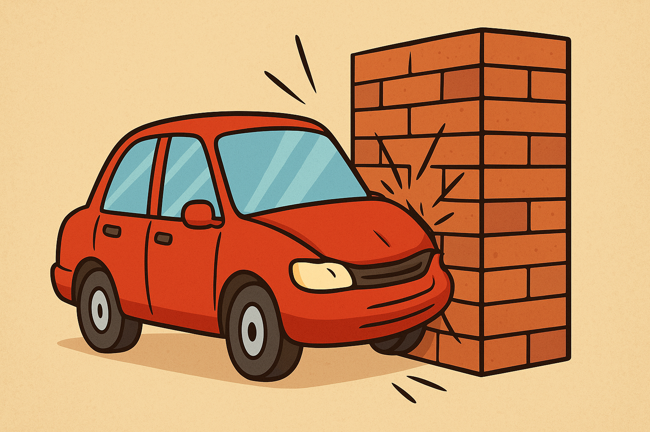
AI Regulation: progress is currently limited
AI Regulation
Current US Administration
EU and UK regulation has started. How to enforce?
Notes:
I asked CGPT to produce a diagram of a car crashing into a brick wall. It replied it could not show violence and offered this picture. I left it in for a laugh.
Remember in late 2023, Rishi Sunak, then UK Conservative Prime Minister, convened a conference at Bletchley Park with world leaders on AI Safety, where significant agreements were made to draw up regulations to control AI. Then Trump came to power …. End of story. Now. EU legislation is being strongly criticised by US tech suppliers for holding back innovation on AI within the EU. And the EU may be fearful of applying its laws to US tech giants for fear of stirring Trump’s wrath.
The Economist reported (19/11/25) that Ofcom, the Regulator for the UK’s On-line Safety Act is working closely with the Big Tech companies to help them come into line with the Act, especially as regards protecting children
There is speculation that ultimately the US and China will have to agree on recognizing each other’s AI if they are to have any trust.

Slide 26
The hype: ‘Artificial Superintelligence’ will take over from humans
NOT CREDIBLE!
Impossible to build ‘Superhuman’ intelligence on the current AI technology
To take over from humanity, each ‘ASI’ system will need to
  cooperate with other ASI systems
  invent and agree common objectives
  plan, and be able to execute their plans
ASI, even if it can be developed, can only take over from humanity if humanity allows it
Notes:
Suggestion made by a colleague: ‘We don’t need ASI. Just allow social media to continue the rot, dumbing down humans to below the intelligence level of current AI, which we can then ask to take over

Slide 27
Agenda
Some background on AI
Why AI is different and vastly inferior to human intelligence
Real risks of current AI and how to counter them
The wider risks to society that should concern us
Summary and Conclusions

Slide 28
Summary
AI is a revolutionary technology, with great potential
Very specialized AI systems, e.g. robotaxis, X-ray scan analysers, are exhaustively tested and/or controlled by experts, and can be trusted
LLM s and their apps, e.g. chatbots, are fallible. They make a variety of mistakes and should not be relied on for important decisions. Cross-check with other reliable sources
Going on-line to the web, social media, e-mail, etc., entails risks which you have learned to manage. It’s exactly the same for AI tools. Learn to manage the risks and you will be safe and can have fun
Social Media have already damaged human behaviour. Children must be taught to handle all technologies safely
AI systems pose many other challenges, e.g. job losses, copyright breaches, power demands. Regulations must prioritise child-safety
Notes:
There are risks when driving cars. But we know about them and happily get in our car. It’s no different when going on-line. We must learn to recognise and to manage the risks

Slide 29
The human brain and AI are both
amazing, quite different,
and no-one fully understands either of them
AI tools, if used carefully, can be powerful aids to humans, and you can have fun with them
Artificial Intelligence
‘Advanced Statistical Systems’ (ASS)
Notes:
The acronym ASS is very appropriate.
Another name for AI is a ‘stochastic parrot’

Slide 30
Thank you
Sleep well tonight
If you would like to discuss further, pl contact me cr.symons@btinternet.com

